Slide 1

Delegate features extraction to a
Convolutional Neural Networks
Author:
Gabriele Chiriatti
Alexander Grajales Quintero Duverley
September 27, 2018

Slide 2
Introduction
Convolutional neural networks are deep artificial neural networks that are used primarily to classify images (e.g. name what they see), cluster them by similarity (photo search), and perform object recognition within scenes. They are algorithms that can identify faces, individuals, street signs, tumors, platypuses and many other aspects of visual data.
The efficacy of convolutional nets in image recognition is one of the main reasons why the world has woken up to the efficacy of deep learning. They are powering major advances in computer vision (CV), which has obvious applications for self-driving cars, robotics, drones, security, medical diagnoses, and treatments for the visually impaired.

Slide 3
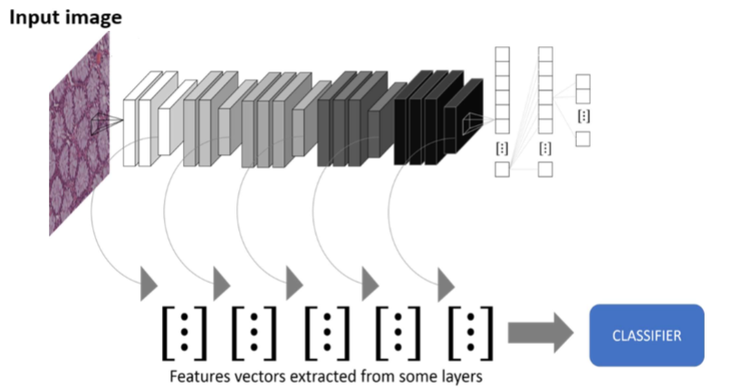
Feature Extractor
The main benefit of using a CNN over simple ANN on visual data is that CNN’s are constrained to deal with image data exclusively. One of the main features of CNN is weight sharing, as a result it reduces the number of weights significantly.Furthermore high quality images consists a very high number of pixels which can lead to a very high number of weights if you use simple ANN , here we can understand the need of CNN and how can they scale to high resolution images also. Another advantage of CNN is that they are very good feature extractors. This means that you can extract useful attributes from an already trained CNN with its trained weights by feeding your data on each level and tune the CNN a bit for the specific task. Infact is only needed to not use the classifier. The output will be only a series of features for each image.

Slide 4
Keras
Keras (https://keras.io/) is an open source neural network library written in Python. It is capable of running on top of TensorFlow, Microsoft Cognitive Toolkit or Theano.\\Designed to enable fast experimentation with deep neural networks, it focuses on being user-friendly, modular, and extensible.Keras provide deep learning models that are made available alongside pre-trained weights. These models can be used for prediction, feature extraction, and fine-tuning.All the methods have been trained on the ImageNet database. \url{ https://keras.io/applications/}\\\\
The principal models are:
VGG16
VGG19
ResNet50
InceptionV3
InceptionResNetV2
MobileNet
DenseNet
NASNet

Slide 5
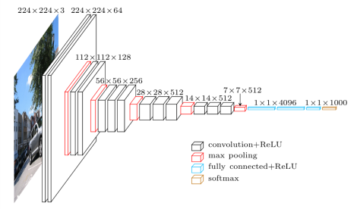
VGG16 and VGG19
The VGG network architecture was introduced by Simonyan and Zisserman in their 2014 paper, Very Deep Convolutional Networks for Large Scale Image Recognition.
This network is characterized by its simplicity, using only 3×3 convolutional layers stacked on top of each other in increasing depth.Reducing volume size is handled by max pooling. Two fully-connected layers, each with 4,096 nodes are then followed by a softmax classifier.
The “16” and “19” stand for the number of weight layers in the network.
In 2014, 16 and 19 layer networks were considered very deep (although we now have
the ResNet architecture which can be successfully trained at depths of 50-200
for ImageNet and over 1,000 for CIFAR-10).

Slide 6
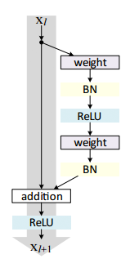
ResNet50
ResNet50 is a 50 layer Residual Network. There are other variants like ResNet101 and ResNet152 also.
ResNet is a short name for Residual Network.
As the name of the network indicates, the new terminology that this network introduces is residual learning.
In general, in a deep convolutional neural network, several layers are stacked and are trained to the task at hand.
The network learns several low/mid/high level features at the end of its layers.In residual learning, instead of trying to learn some features, we try to learn some residual.
Residual can be simply understood as subtraction of feature learned from input of that layer. ResNet does this using shortcut connections (directly connecting input of nth layer to some (n+x)th layer).
It has proved that training this form of networks is easier than training simple deep convolutional neural networks and also the problem of degrading accuracy is resolved.

Slide 7
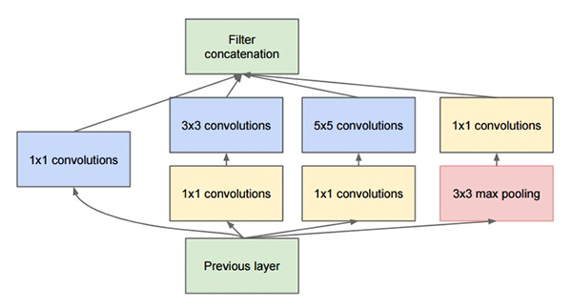
InceptionV3
The “Inception” micro-architecture was first introduced by Szegedy et al. in their 2014 paper.
The goal of the inception module is to act as a “multi-level feature extractor” by computing 1×1, 3×3, and 5×5 convolutions within the same module of the network — the output of these filters are then stacked along the channel dimension and before being fed into the next layer in the network.
The original incarnation of this architecture was called GoogLeNet, but subsequent manifestations have simply been called Inception vN where N refers to the version number put out by Google.
The Inception V3 architecture included in the Keras core comes from the later publication by Szegedy et al., Rethinking the Inception Architecture for Computer Vision (2015) which proposes updates to the inception module to further boost ImageNet classification accuracy.
The weights for Inception V3 are smaller than both VGG and ResNet, coming in at 96MB.

Slide 8
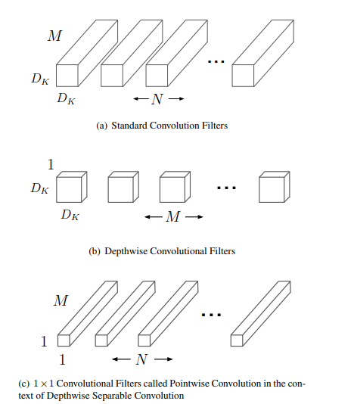
MobileNet
The MobileNet is introduced by Andrew G. Howard, Menglong Zhu, Bo Chen, Dmitry Kalenichenko, Weijun Wang, Tobias Weyand, Marco Andreetto, Hartwig Adam in their paper in 2017.
The MobileNet model is based on depth wise separable convolutions which is a form of factorized convolutions which factorize a standard convolution into a depthwise convolution and a 1×1 convolution called a pointwise convolution. For MobileNets the depthwise convolution applies a single filter to each input channel. The pointwise convolution then applies a 1×1 convolution to combine the outputs the depthwise convolution.
A standard convolution both filters and combines inputs into a new set of outputs in one step. The depthwise separable convolution splits this into two layers, a separate layer for filtering and a separate layer for combining. This factorization has the effect of drastically reducing computation and model size.
The standard convolutional filters in (a) are replaced by two layers: depthwise convolution in (b) and pointwise convolution in (c) to build a depthwise separable filter.

Slide 9
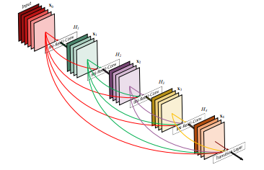
DenseNet
The DenseNet is introduced by Gao Huang,Zhuang Liu,Laurens van der Maaten
To further improve the information flow between layers DenseNet propose a different connectivity pattern: introduce direct connections from any layer to all subsequent layers.
The figure illustrates the layout of the resulting DenseNet schematically

Slide 10
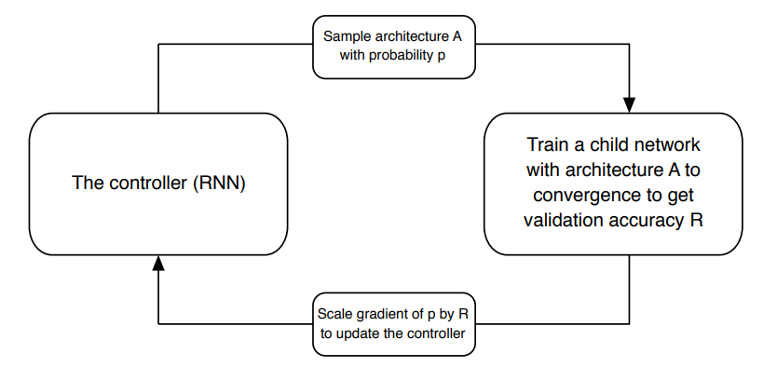
NASNet
The NesNet is introduced by Barret Zoph,Vijay Vasudevan,Jonathon Shlens,Quoc V. Le.
NASNet is capable of producing small neural networks which performed as well as those designed by humans. The main search method used in this work is the Neural Architecture Search (NAS): a controller recurrent neural network (RNN) samples child networks with different architectures.The child networks are trained to convergence to obtain some accuracy on a held-out validation set.The resulting accuracies are used to update the controller so that the controller will generate better architectures over time.The controller weights are updated with policy gradient.
A controller RNN predicts architecture A from a search space with probability p. A child network with architecture A is trained to convergence achieving accuracy R. Scale the gradients of p by R to update the RNN controller.

Slide 11
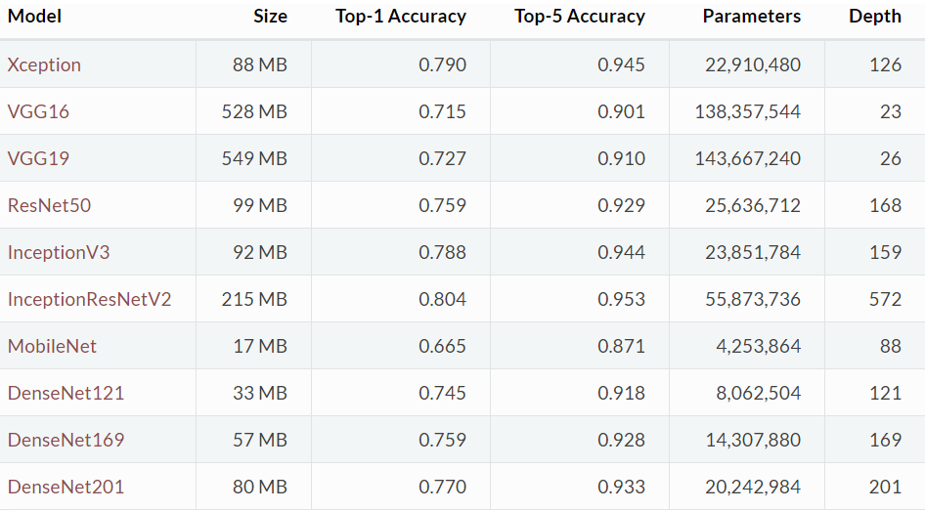
In synthesis:

Slide 12
Dimensionality Reduction
The problem is that the features have a large number of variables. In other words, they have a high number of dimensions along which the data is distributed. Visually exploring the data can then become challenging and most of the time even practically impossible to do manually. However, such visual exploration is incredibly important in any data-related problem. Therefore it is key to understand how to visualise high-dimensional datasets.
This can be achieved using techniques known as dimensionality reduction (Unsupervised learning) .
We will focus on two techniques that will allow us to do this: PCA and t-SNE.

Slide 13
PCA
Principal component analysis (PCA) was invented in 1901 by Karl Pearson, as an analogue of the principal axis theorem in mechanics; it was later independently developed and named by Harold Hotelling in the 1930s. PCA is a technique for reducing the number of dimensions in a dataset whilst retaining most information. It is using the correlation between some dimensions and tries to provide a minimum number of variables that keeps the maximum amount of variation or information about how the original data is distributed. It does not do this using guesswork but using hard mathematics and it uses something known as the eigenvalues and eigenvectors of the data-matrix. These eigenvectors of the covariance matrix have the property that they point along the major directions of variation in the data. These are the directions of maximum variation in a dataset.
t-SNE
T-distributed Stochastic Neighbor Embedding (t-SNE) is a machine learning algorithm for visualization developed by Laurens van der Maaten and Geoffrey Hinton. It is a nonlinear dimensionality reduction technique well-suited for embedding high-dimensional data for visualization in a low-dimensional space of two or three dimensions. Specifically, it models each high-dimensional object by a two- or three-dimensional point in such a way that similar objects are modeled by nearby points and dissimilar objects are modeled by distant points with high probability.

Slide 14
Supervised Classifier
When the reduced features are obtained need a classifier to recognize different images, this is made with a supervised algorithm. Supervised learning is the machine learning task of learning a function that maps an input to an output based on example input-output pairs.It infers a function from labeled training data consisting of a set of training examples. In supervised learning, each example is a pair consisting of an input object (typically a vector) and a desired output value (also called the supervisory signal). A supervised learning algorithm analyzes the training data and produces an inferred function, which can be used for mapping new examples. An optimal scenario will allow for the algorithm to correctly determine the class labels for unseen instances. This requires the learning algorithm to generalize from the training data to unseen situations in a "reasonable" way.
In our work the supervised method used are:
k-NN: k-nearest neighbors.
SVM : Support Vector Machine.

Slide 15
k-NN
In pattern recognition, the k-nearest neighbors algorithm (k-NN) is a non-parametric method used for classification and regression.The training examples are vectors in a multidimensional feature space, each with a class label. The training phase of the algorithm consists only of storing the feature vectors and class labels of the training samples.
In the classification phase, k is a user-defined constant, and an unlabeled vector (a query or test point) is classified by assigning the label which is most frequent among the k training samples nearest to that query point.A commonly used distance metric for continuous variables is Euclidean distance. For discrete variables, such as for text classification, another metric can be used, such as the overlap metric (or Hamming distance). In the context of gene expression microarray data, for example, k-NN has also been employed with correlation coefficients such as Pearson and Spearman. Often, the classification accuracy of k-NN can be improved significantly if the distance metric is learned with specialized algorithms such as Large Margin Nearest Neighbor or Neighbourhood components analysis.A drawback of the basic "majority voting" classification occurs when the class distribution is skewed. That is, examples of a more frequent class tend to dominate the prediction of the new example, because they tend to be common among the k nearest neighbors due to their large number.\\ One way to overcome this problem is to weight the classification, taking into account the distance from the test point to each of its k nearest neighbors. The class (or value, in regression problems) of each of the k nearest points is multiplied by a weight proportional to the inverse of the distance from that point to the test point.
Another way to overcome skew is by abstraction in data representation.
For example, in a self-organizing map (SOM), each node is a representative (a center)
of a cluster of similar points, regardless of their density in the original training data.
K-NN can then be applied to the SOM.

Slide 16
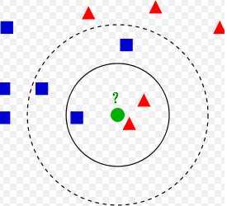
The test sample (green circle) should be classified either to the first class of blue squares or to the second class of red triangles. If k = 3 (solid line circle) it is assigned to the second class because there are 2 triangles and only 1 square inside the inner circle. If k = 5 (dashed line circle) it is assigned to the first class (3 squares vs. 2 triangles inside the outer circle).

Slide 17
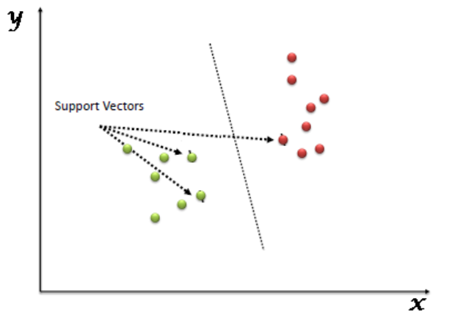
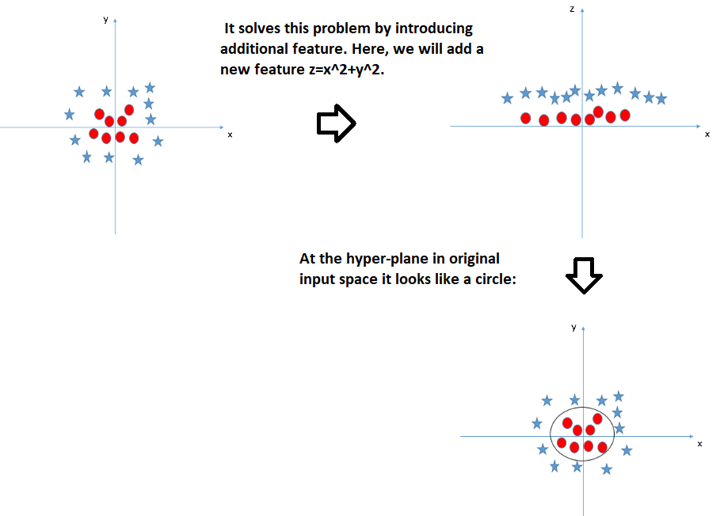
SVM
Support Vector Machine (SVM) is a supervised machine learning algorithm which can be used for both classification or regression challenges. However, it is mostly used in classification problems. In this algorithm, we plot each data item as a point in n-dimensional space (where n is number of features you have) with the value of each feature being the value of a particular coordinate. Then, we perform classification by finding the hyper-plane that differentiate the two classes very well.
Support Vectors are simply the co-ordinates of individual observation. Support Vector Machine is a frontier which best segregates the two classes (hyper-plane/ line).In addition to performing linear classification, SVMs can efficiently perform a non-linear classification using what is called the kernel trick.These are functions which takes low dimensional input space and transform it to a higher dimensional space i.e. it converts not separable problem to separable problem, these functions are called kernels. It is mostly useful in non-linear separation problem. Simply put, it does some extremely complex data transformations, then find out the process to separate the data based on the labels or outputs you’ve defined.

Slide 18
The principal advantages of SVM are:
It works really well with clear margin of separation.
It is effective in high dimensional spaces.
It is effective in cases where number of dimensions is greater than the number of samples.
It uses a subset of training points in the decision function (called support vectors), so it is also memory efficient.\\\\
The drawback are:
It doesn’t perform well, when we have large data set because the required training time is higher.
It also doesn’t perform very well, when the data set has more noise i.e. target classes are overlapping.
SVM doesn’t directly provide probability estimates, these are calculated using an expensive five-fold cross-validation. It is related SVC method of Python scikit-learn library.
In Python, scikit-learn is a widely used library for implementing machine learning algorithms,SVM is also available in scikit-learn library and follow the structure:Import library, object creation, fitting model and prediction

Slide 19
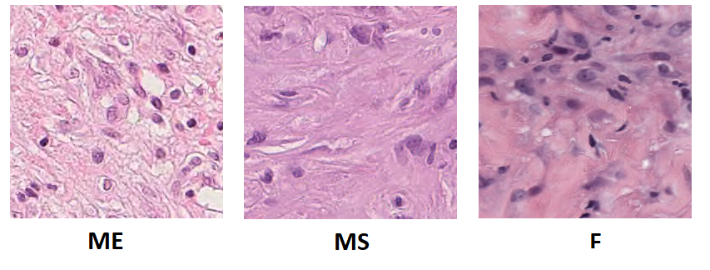
Image Data Set
The images represent histological samples of subjects looking for lung lesions. These problems can be benign or malignant.
In particular represent:
Epithelioid Mesothelioma (ME) malignant tumor.
Sarcomatoid Mesothelioma (MS) malignant tumor.
Benign Fibrosis (F).
In our Data Set there are 998 ME images, 1001 MS image and 333 F images.

Slide 20
The Project
In our work we used different Keras pre-trained model as features extractrion. For each model we try to extract level from different depth level of the net.
The model used are:
VGG16
VGG19
MobileNet
DenseNet
InceptionResNetV2
ResNet50
Xception
The feature are subsequently reduced with PCA and t-SNE algorithm.
The images of features extraction of the following images are taken from
the last layer in the net as example.

Slide 21
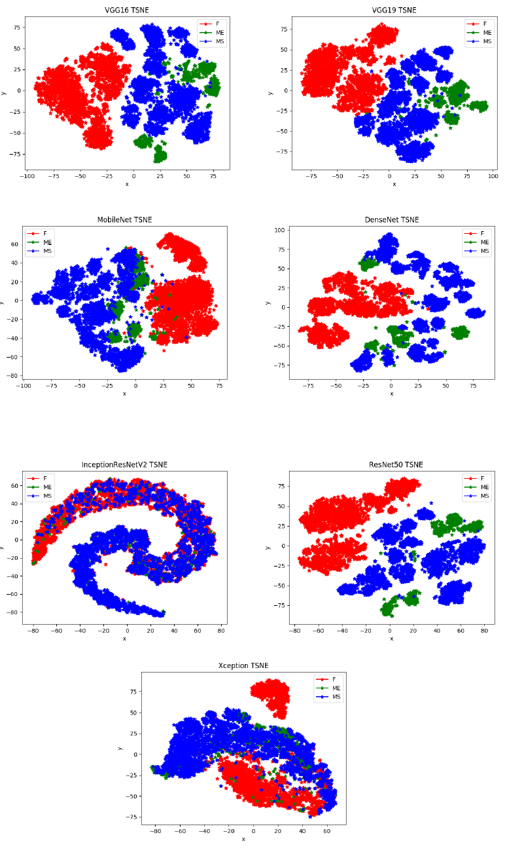
t-SNE
A drawback of this tecnique is that the t-SNE is not linear method so is not possible to save weights for a new image. We need to reuse t-SNE for all the images so to restart again with the full set. This problem is not present if we use PCA method that is linear.

Slide 22
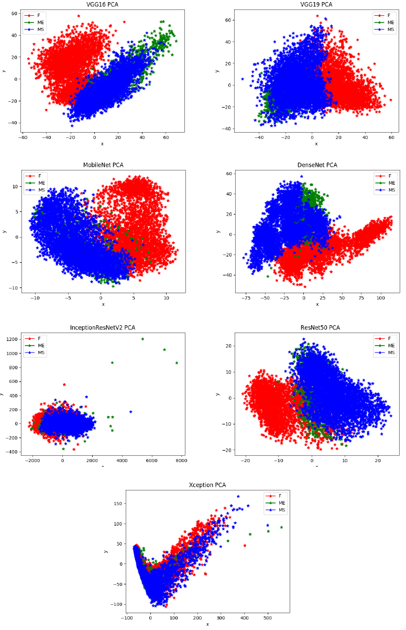
PCA
In this casethe PCA is applicated for 2 dimensions extraction (not racomanded)
The output is the worst result..

Slide 23
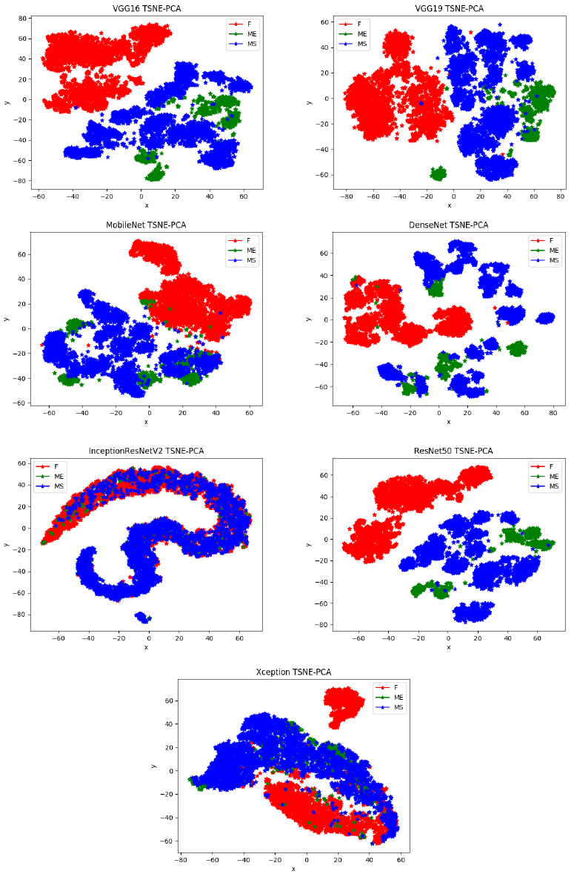
PCA and t-SNE
The best solution to visualize our data is to combine the two method: is possible to reduce features with PCA and use t-SNE to reduce features to two.
%%%%%%%%%%%%%%%%%%%%%%%%%%

Slide 24
PCA and t-SNE for Intermediate layer
The following images are taken from the intermediate layer in particular from:
Middle layer
First layer
Anyway the user can select any layer during program execution. The layer is chosen by name.
All the name layer are printed on screen during the execution of the program.

Slide 25
Middle layer

Slide 26
First layer

Slide 27
Supervised Classifier
In order to classify our image a Supervised Classifier is needed.
In our work we used two different classifier:
k-NN:k-nearest neighbors.
SVM:Support Vector Machine.
For both method the accuracy of the model is calculated. The input features (calculated from the Keras pre trained model) are have been reduced with PCA.
The default number of component is 50 but is also modificable by the user.

Slide 28
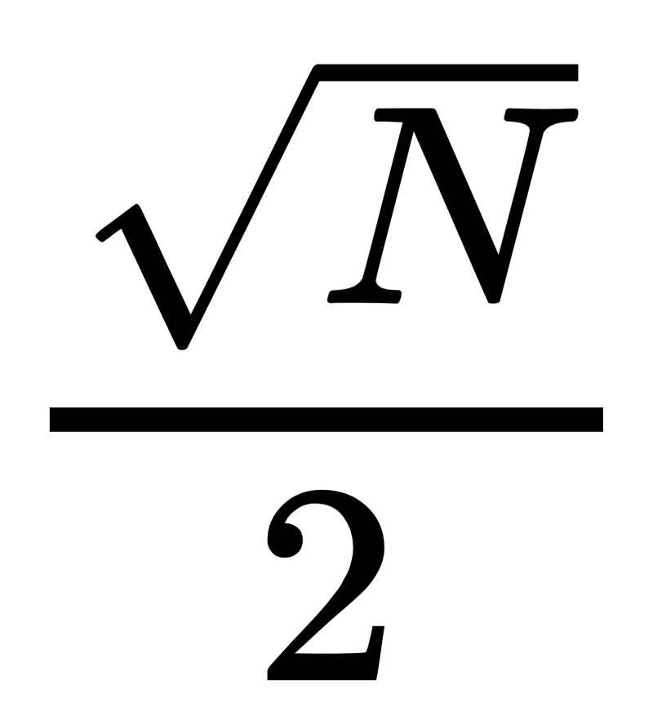
Result k-NN
In the k-NN algorithm the number of neighbour is chosen by the user. The default number is 5. For a optimal number of neighbour ,in literature, is suggested to use a formula:
Where N is the number of training sample in the dataset.

Slide 29
Result SVM
For Multi-class classification the SVM the scikit-learn library use two different approach selectable by command line:
“one-vs-the-rest”
“one-vs-one”

Slide 30
Visual Categorization with Bags of Keypoints
The bag of keypoints method was created by Gabriella Csurka, Christopher R. Dance, Lixin Fan, Jutta Willamowski, Cédric Bray in 2004.
The main steps of the method are:
Detection and description of image patches
Assigning patch descriptors to a set of predetermined clusters (a vocabulary) with a vector quantization algorithm
Constructing a bag of keypoints, which counts the number of patches assigned to each cluster
Applying a multi-class classifier, treating the bag of keypoints as the feature vector, and thus determine which category or categories to assign to the image.
MatLab 2017 provide a tool to use this method.
Two different cases are analyzed:
The 30\% of images from each set are used for the training data and the remainder, 70\%, for the validation data.
The 50\% of images from each set are used for the training and validation data.

Slide 31
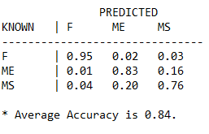
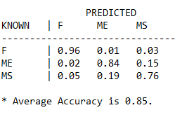
Result Bags of Keypoints
The confusion matrix for the first case is:
While in the second case the confusion matrix is:

Slide 33
Conclusion

